Slide 1

The Problem
Many farms have switched to planting genetically–modified (GMO) crops that are designed to resist herbicides. As a result, use of weed killers has skyrocketed in recent years.

Slide 2
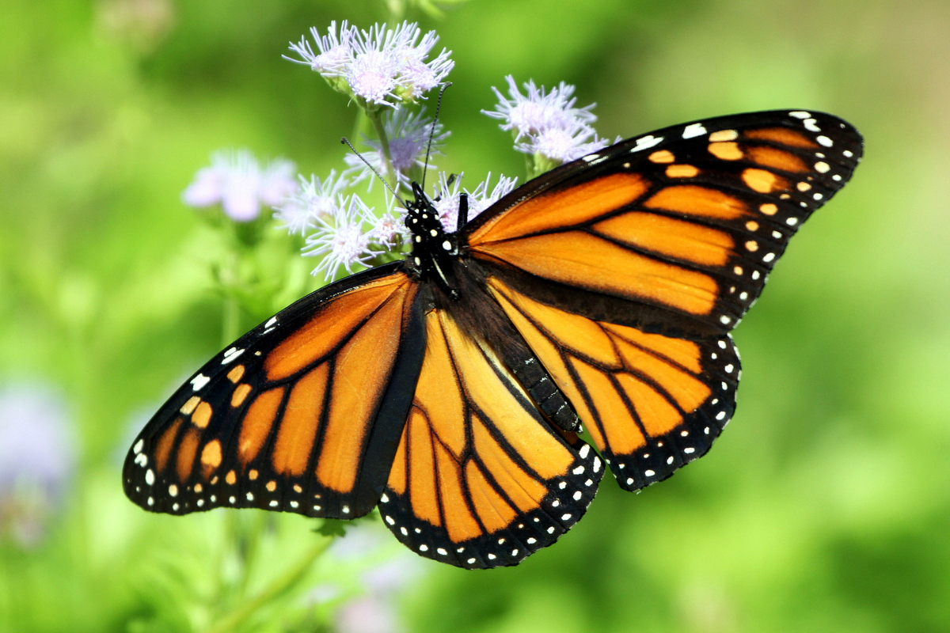
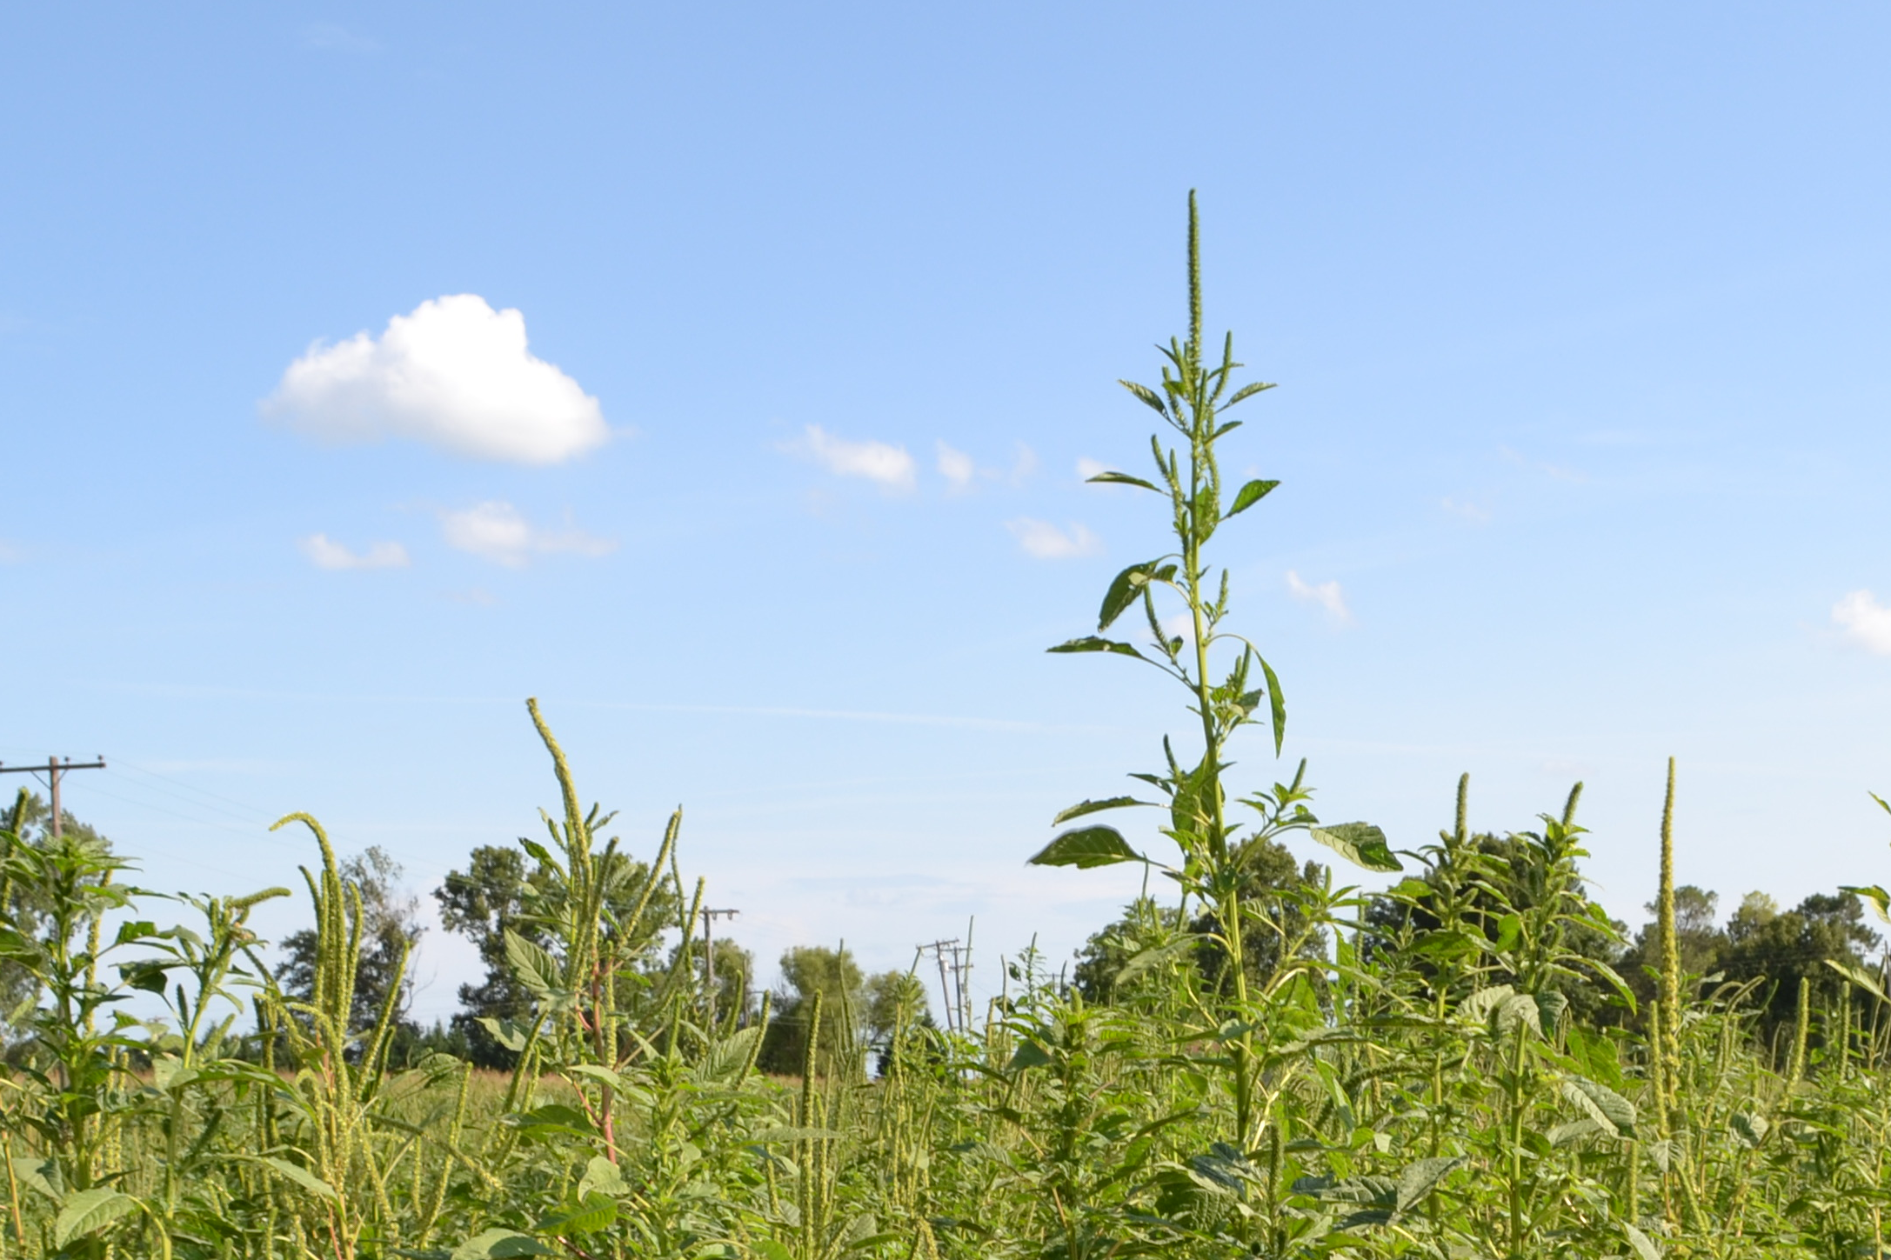

Consequences
Species Declines
Herbicides kill host plants of butterflies. In the eastern US, Monarchs have declined by 90% in the last 20 years.
1
Weed Resistance
Some weeds have evolved resistance to herbicides. This leads to even more herbicide use (a vicious cycle).
2
Public Health
The most common herbicide in use, glyphosate (Roundup), has recently been linked to cancer in humans.
3

Slide 3
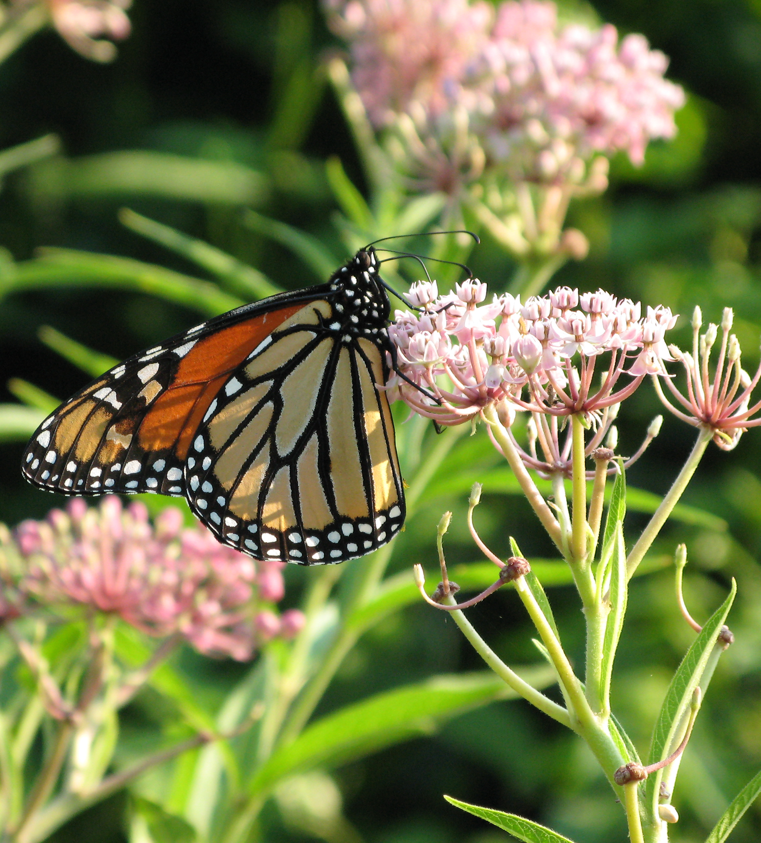
1
What Can You Do about It?
Plant a Pollinator Garden
Help butterflies and other pollinators by planting:
nectar flowers for adults, like buttonbush and mistflower
host plants for larvae, like milkweed and violets
pollinator-friendly trees, like black cherry and redbud
Use plants native to your area. Avoid non-native invasive plants like butterfly bush!

Slide 4
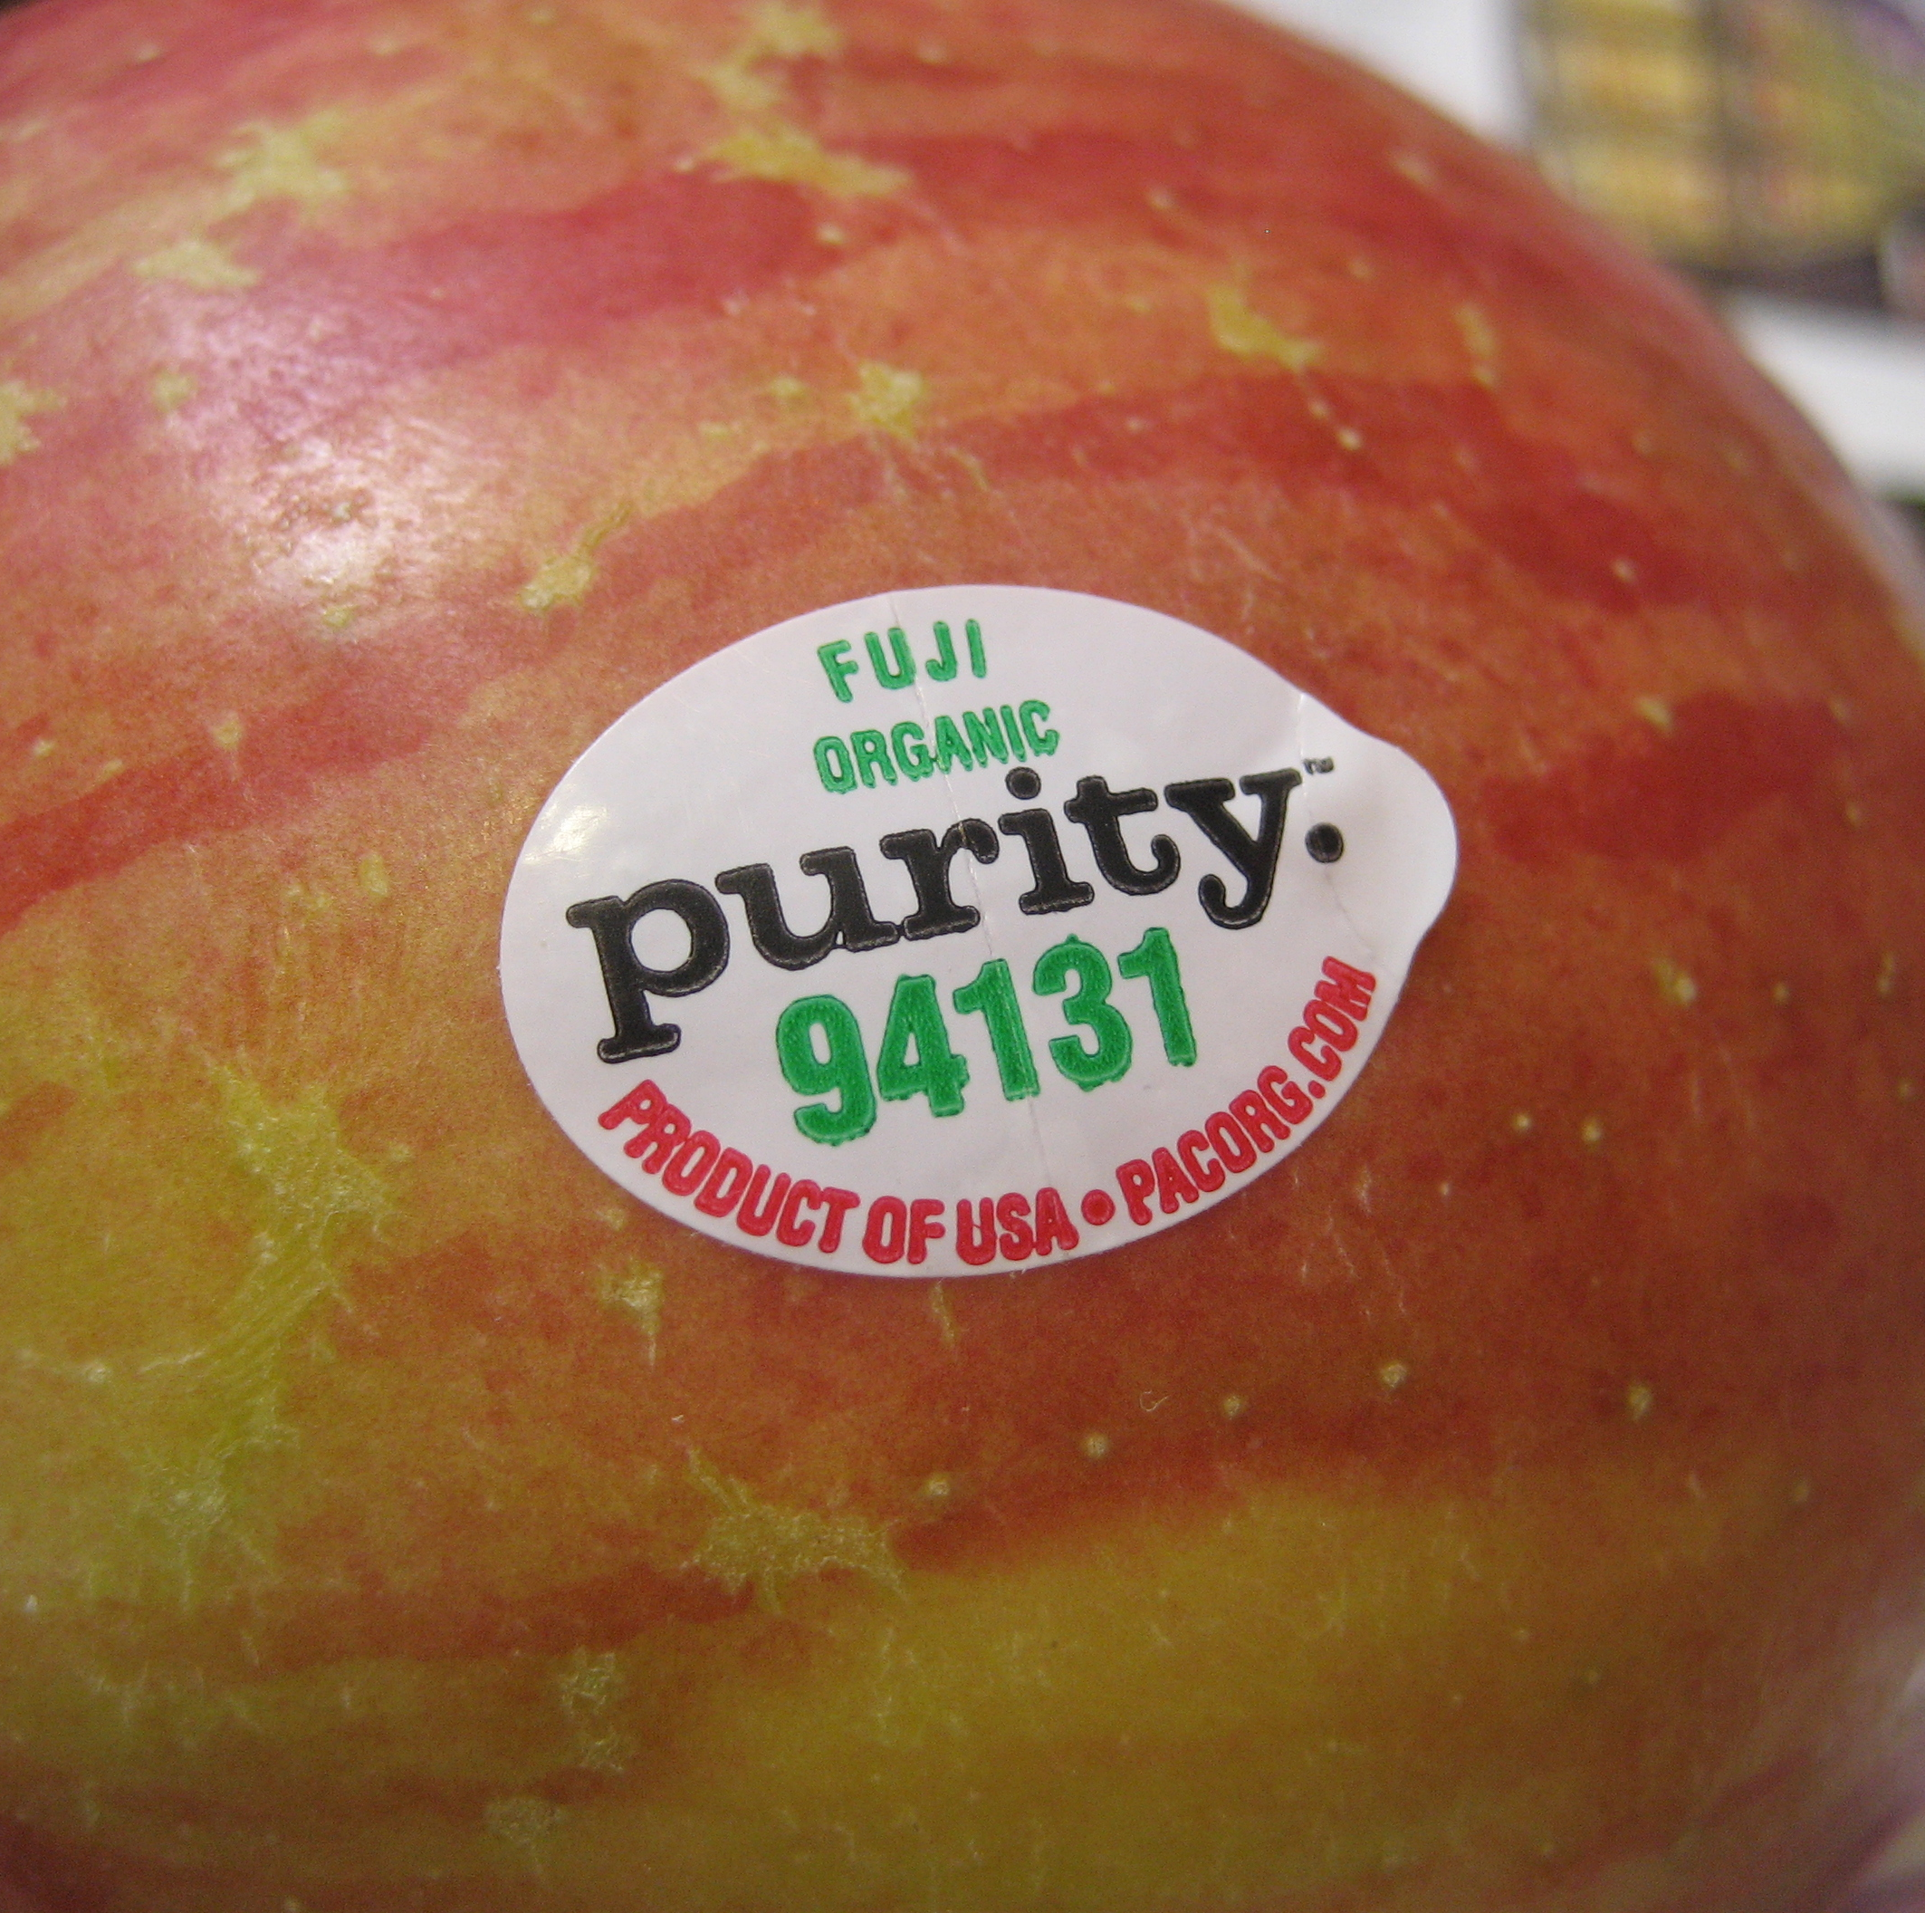
2
What Can You Do about It?
Buy Smart
Help reduce the use of harmful herbicides:
Buy organic foods; they’re much gentler on the environment! (Look for produce labels that start with “9”.)
Use eco-friendly herbicides or remove weeds by hand.
Ask your garden center for pesticide-free plants and non-GMO seeds.
Help reduce the use of harmful herbicides by buying organic foods when possible.
Organic fruits and vegetables are grown without the use of herbicides or pesticides. Organic meat comes from animals that are fed organic crops. Although organic foods are more expensive, they are much better for the environment!

Slide 5

3
What Can You Do about It?
Support GMO Labeling
Support legislation to require labeling of foods made from genetically-modified organisms (GMOs).
Labeling of GMOs is already required in many parts of the world, including the European Union. GMO food labels allow consumers to make informed decisions about the foods they buy.

Slide 6
Credits
All photos used under Creative Commons licenses:
https://creativecommons.org/licenses/by-sa/2.0/legalcode
“Herbicide” by Kevin Wood via flickr.com
https://creativecommons.org/licenses/by-nc/2.0/legalcode
“Monarch” TexasEagle via flickr.com
“Asclepias incarnata, swamp milkweed” by Suzanne Cadwell via flickr.com (cropped)
https://creativecommons.org/licenses/by/2.0/legalcode
“Palmer Amaranth in the Field” by United Soybean Board via flickr.com (cropped)
https://creativecommons.org/licenses/by-nc-nd/2.0/legalcode
“Checking Blood Sample” by National Eye Institute via flickr.com (cropped)
https://creativecommons.org/licenses/by-nd/2.0/legalcode
“IMG_1011.JPG” (fruit) by Jason Tester Guerrilla Futures via flickr.com (cropped)

